Slide 1
Satellite Communication

Slide 2
Orbital Mechanics

Slide 3
Orbital Mechanics
To achieve a stable orbit around the earth, a spacecraft must first be beyond the bulk of the earth’s atmosphere, i.e., in what is popularly called space.
According to Newton's law of motion F=ma. Where a = acceleration, F= force acting on the object and m= mass of the object. It helps us understand the motion of satellite in a stable orbit.(neglecting any drag or other perturbing forces). (F=ma) states that the force acting on a body is equal to the mass of the body multiplied by the resulting acceleration of the body.  Thus, for a given force, the lighter the mass of the body, the higher the acceleration will be.
When in a stable orbit, there are two main forces acting on a satellite: a centrifugal force due to the kinetic energy of the satellite, which attempts to fling the satellite into a higher orbit, and a centripetal force due to gravitational attraction of the planet about which the satellite is orbiting, which attempts to pull the satellite towards the planet. If these two forces are equal the satellite remains in a stable orbit.

Slide 4
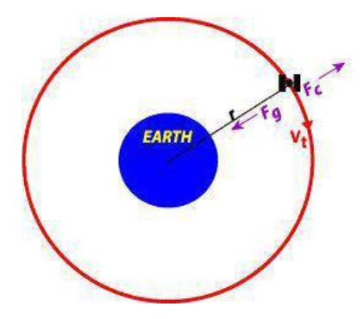

Slide 5
Involvement of Two relevant forces
1.Gravitational force= attraction between any two objects 2.Centrifugal force=an outward directed force
that normally balances the inward directed centripetal force.
The standard acceleration due to gravity at the earth surface is 981 cm/s². This value decreases with height above the earth’s surface. The acceleration a due to gravity at a distance r from the centre of the earth is a=µ/r² km/ s² Where the constant µ is the product of the universal gravitational constant G and the mass of the earth M_{E}. The product GM_{E} is called kepler’s constant and has the value
3.98 x 10⁵ km³/s².
The universal gravitational constant is G=6.672x 10⁻¹¹ Nm²/kg².

Slide 6
Involvement of Two relevant forces
The mass of the earth M_{E} =5.97 x 1024 kg.
Since force= mass x acceleration, the centripetal force acting on the satellite, F_{in} is given by
F_{in}= m x (µ/r²) =m x (G M_{E} /r² )
In a similar fashion, the centrifugal acceleration is given by a=v²/r
Where, v is the velocity of satellite.
Which will give the centrifugal force, F_{out} as F_{out}=m x(v² /r )
If the forces of the satellite are balanced F_{in}=F_{out}
m x (µ/r²)=m x(v² /r )
Hence the velocity v of the satellite in a circular orbit is given by v=(µ/r)^{1/2}

Slide 7
Involvement of Two relevant forces
If the orbit is circular, the distance traveled by a satellite in one orbit around a planet is 2∏r , where r is the radius of the orbit from the satellite to the center of the planet. Since distance divided by velocity equals time to travel the distance, the period of satellite’s orbit T, will be
T= (2∏r )/v = (2∏r )/[(µ/r)^{1/2}]
T=(2∏r ^{3/2})/(µ^{1/2})
Using standard mathematical procedures one can develop an equation for the radius of the satellite’s orbit r.

Slide 8
Kepler’s Law
Kepler’s Laws Kepler’s laws of planetary motion apply to any two bodies in space that interact through gravitation. The laws of motion are described through three fundamental principles.
Kepler’s First Law as it applies to artificial satellite orbits, can be simply stated as follows: ‘The path followed by a satellite around the earth will be an ellipse, with the center of mass of earth as one of the two foci of the ellipse.’
If no other forces are acting on the satellite, either intentionally by orbit control or unintentionally as in gravity forces from other bodies, the satellite will eventually settle in an elliptical orbit, with the earth as one of the foci of the ellipse. The ‘size’ of the ellipse will depend on satellite mass and its angular velocity. Kepler’s Second Law can likewise be simply stated as follows: ‘for equal time intervals, the satellite sweeps out equal areas in the orbital plane.’ Figure 2.3 demonstrates this concept.

Slide 9
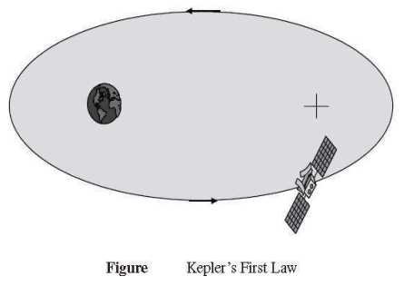
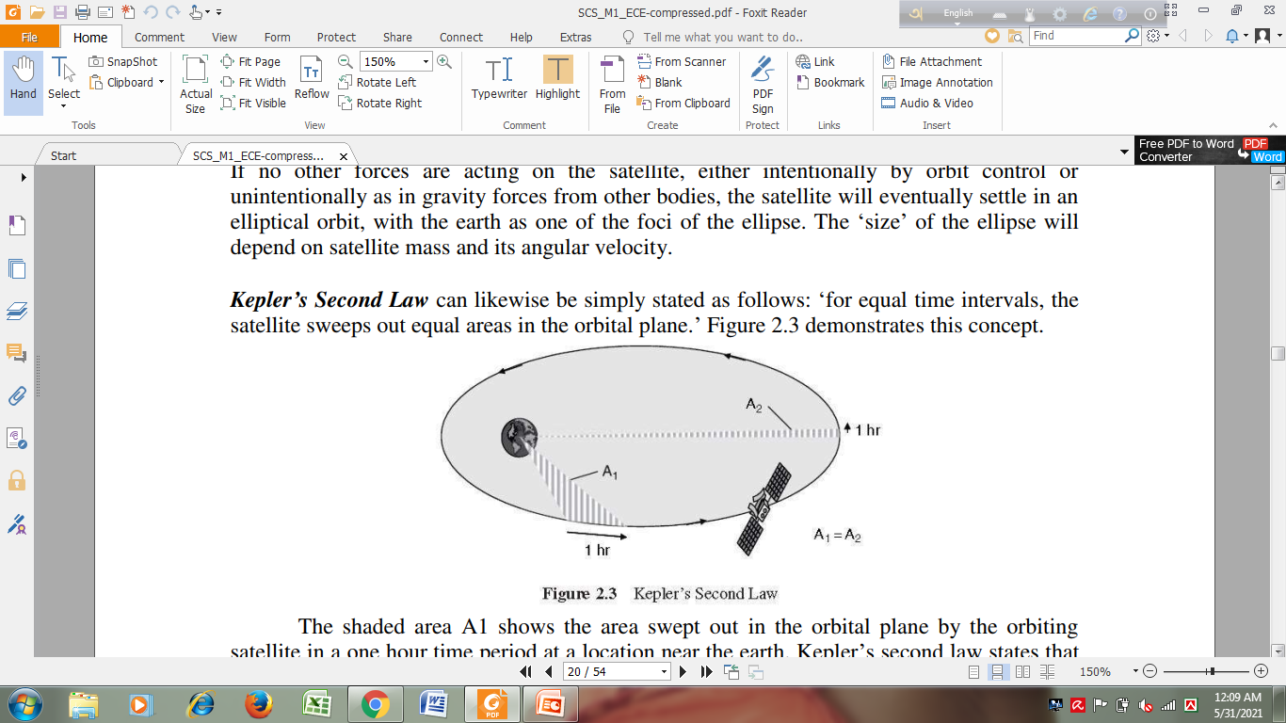

Slide 10
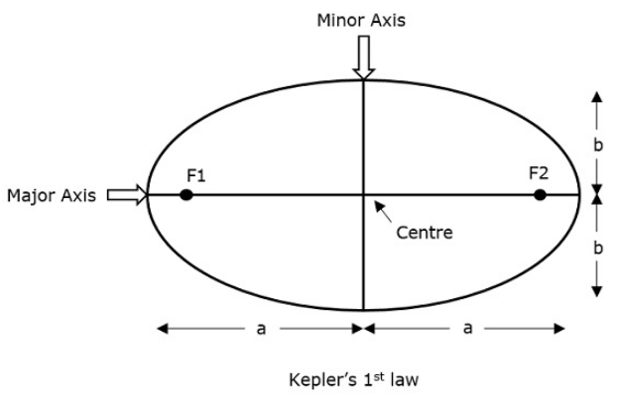
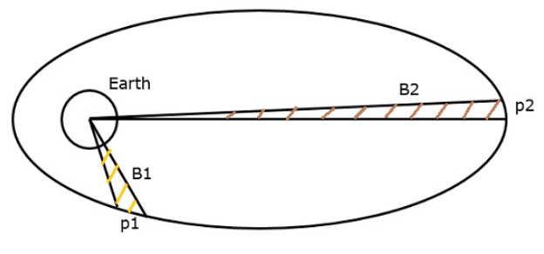

Slide 11
Kepler’s Law
The shaded area A1 shows the area swept out in the orbital plane by the orbiting satellite in a one hour time period at a location near the earth. Kepler’s second law states that the area swept out by any other one hour time period in the orbit will also sweep out an area equal to A1. For example, the area swept out by the satellite in a one hour period around the point farthest from the earth (the orbit’s apogee), labeled A2 on the figure, will be equal to A1, i.e.: A1 =A2. This result also shows that the satellite orbital velocity is not constant; the satellite is moving much faster at locations near the earth, and slows down as it approaches perigee.
Kepler’s Third Law ‘the square of the periodic time of orbit is proportional to the cube of the mean distance between the two bodies.’ This is quantified as follows:T²=[4π²/μ] a³ constant=[4π²/μ]
Where T=orbital period in second
a=distance between the two bodies, in km µ=Kepler’s Constant =3.986004×10⁵ km³/s²

Slide 12
Kepler’s Law
If the orbit is circular, then a=r, and
orbit radius = [constant] × (orbit Period)^{2/3}
Under this condition, a specific orbit period is determined only by proper selection of the orbit radius. This allows the satellite designer to select orbit periods that best meet particular application requirements by locating the satellite at the proper orbit altitude.

Slide 13
Orbital Elements
Apogee: A point for a satellite farthest from the Earth. It is denoted as ha.
Perigee: A point for a satellite closest from the Earth. It is denoted as hp.
Line of Apsides: Line joining perigee and apogee through centre of the Earth. It is the major axis of the orbit. One-half of this line’s length is the semi-major axis equivalents to satellite’s mean distance from the Earth.
Ascending Node: The point where the orbit crosses the equatorial plane going from north to south.
Descending Node: The point where the orbit crosses the equatorial plane going from south to north.
Inclination (i): the angle between the orbital plane and the Earth’s equatorial plane. Its measured at the ascending node from the equator to the orbit, going from East to North. Also, this angle is commonly denoted as i.

Slide 14
Orbital Elements
Line of Nodes: the line joining the ascending and descending nodes through the centre of Earth.
Prograde Orbit: an orbit in which satellite moves in the same direction as the Earth’s rotation. Its inclination is always between 0⁰ to 90⁰. Many satellites follow this path as Earth’s velocity makes it easier to launch these satellites.
Retrograde Orbit: an orbit in which satellite moves in the same direction counter to the Earth’s rotation.
Argument of Perigee (ω): An angle from the point of perigee measure in the orbital plane at the Earth’s centre, in the direction of the satellite motion.

Slide 15
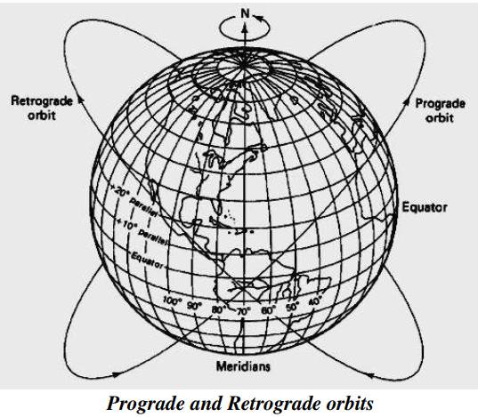

Slide 16
Orbital Elements
Right ascension of ascending node (Ω): The definition of an orbit in space, the position of ascending node is specified. But as the Earth spins, the longitude of ascending node changes and cannot be used for reference. Thus for practical determination of an orbit, the longitude and time of crossing the ascending node is used. For absolute measurement, a fixed reference point in space is required. It could also be defined as “right ascension of the ascending node; right ascension is the angular position measured eastward along the celestial equator from the vernal equinox vector to the hour circle of the object”.
Mean anamoly: It gives the average value to the angular position of the satellite with reference to the perigee.
True anamoly (ν): It is the angle from point of perigee to the satellite’s position, measure at the Earth’s centre.

Slide 17
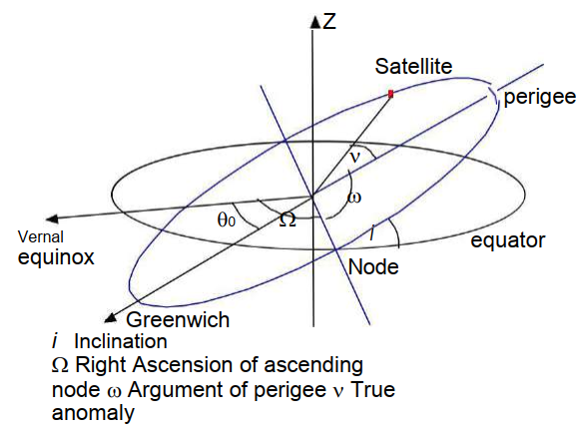

Slide 18
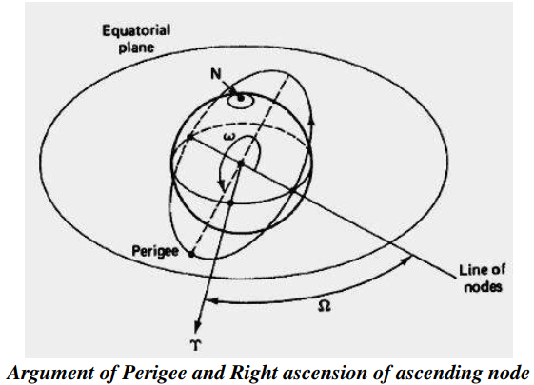

Slide 19
Keplerian Orbital Elements
Following are the 6 elements of the Keplerian Element set commonly known as orbital elements.
Semi-Major axis (a)
Eccentricity (e) = (a²-b²)^{1/2}/a They give the shape (of ellipse) to the satellite’s orbit.
Mean anomaly (M₀) It denotes the position of a satellite in its orbit at a given reference time.
Argument of Perigee It gives the rotation of the orbit’s perigee point relative to the orbit’s nodes in the earth‟s equatorial plane.
Inclination
Right ascension of ascending node

Slide 20
Look Angle
Earth station will receive the maximum signal level, if it is located directly under the satellite. Otherwise, it won’t receive maximum signal level and that signal level decreases as the difference between the latitude and longitude of earth station increases. So, based on the requirement we can place the satellite in a particular orbit.
Look Angles
The following two angles of earth station antenna combined together are called as look angles.
Azimuth Angle
Elevation Angle
Generally, the values of these angles change for non-geostationary orbits. Whereas, the values of these angles don’t change for geostationary orbits. Because, the satellites present in geostationary orbits appear stationary with respect to earth.
These two angles are helpful in order to point at the satellite directly from the earth station antenna. So, the maximum gain of the earth station antenna can be directed at satellite.
We can calculate the look angles of geostationary orbit by using longitude & latitude of earth station and position of satellite orbit.

Slide 21
Look Angle
Azimuth Angle
The angle between local horizontal plane and the plane passing through earth station, satellite and center of earth is called as azimuth angle.
The formula for Azimuth angle (α) is
α=180⁰+Tan⁻¹(TanG/TanL)
Where,
L is Latitude of earth station antenna.
G is the difference between position of satellite orbit and earth station antenna.
It is used to track the satellite horizontally.

Slide 22
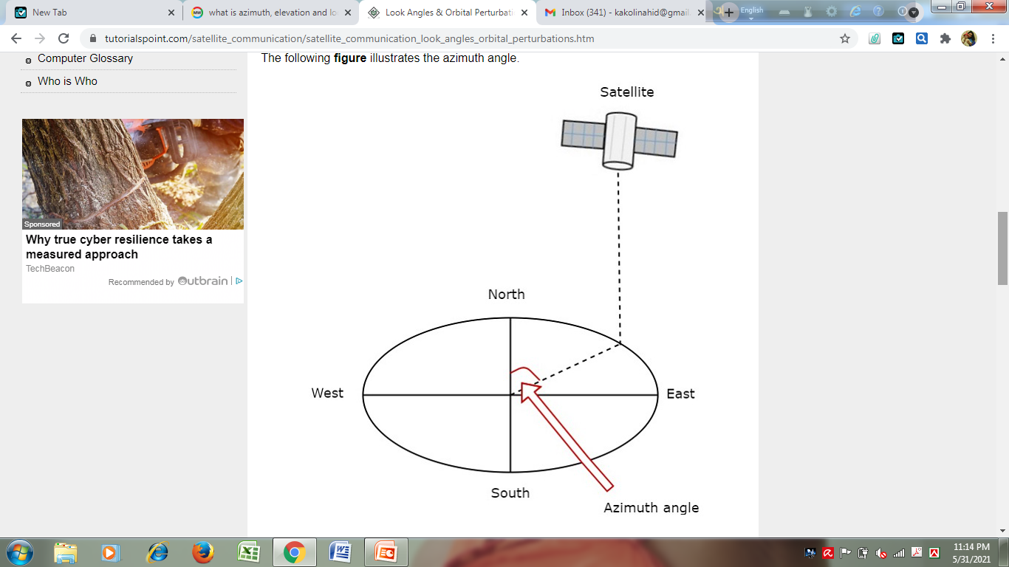

Slide 23
Look Angle
Elevation Angle
The angle between vertical plane and line pointing to satellite is known as Elevation angle. Vertical plane is nothing but the plane, which is perpendicular to horizontal plane.
The formula for Elevation angle (β) is
β=Tan⁻¹((cosG.cosL−0.15)/√(1−cos²G.cos²L)
Measure the vertical angle at earth station antenna from ground to satellite as shown in the figure. It represents elevation angle.

Slide 24
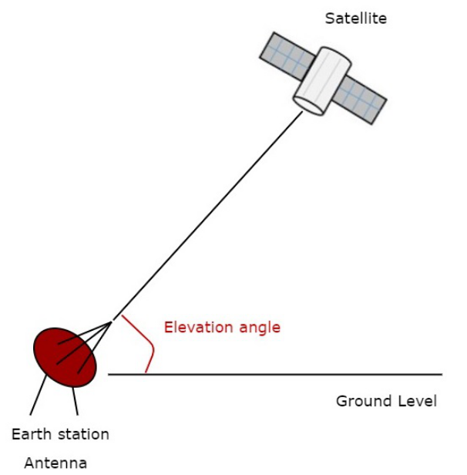

Slide 25
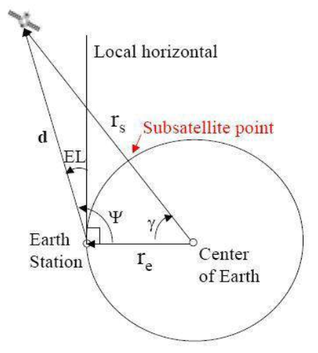
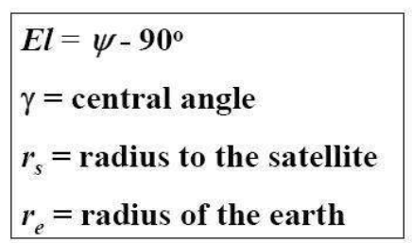

Slide 26
Sub Satellite Point
Point at which a line between the satellite and the center of the Earth intersects the Earth’s surface.
✓ Location of the point expressed in terms of latitude and longitude
✓ If one is in the US it is common to use
o Latitude – degrees north from equator
o Longitude – degrees west of the Greenwich meridian
✓ Location of the sub satellite point may be calculated from coordinates of the rotating system as:

Slide 27
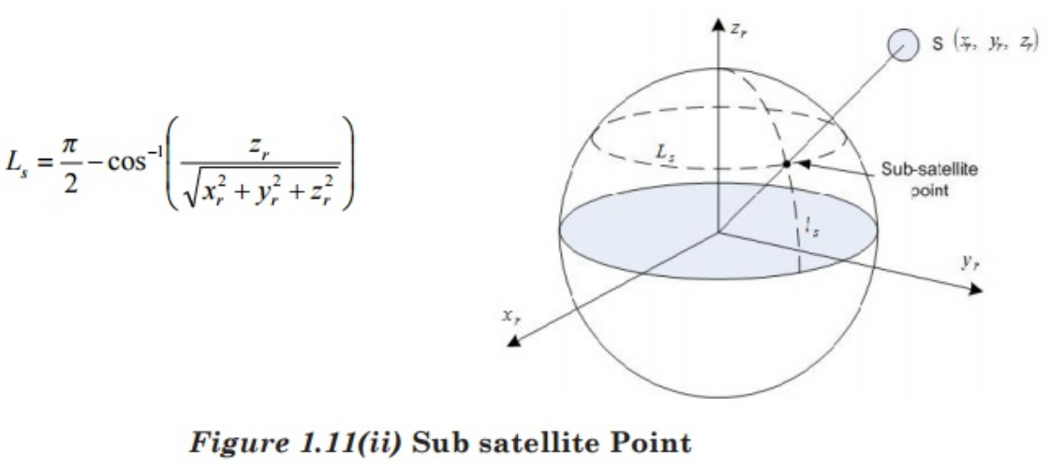
Sub Satellite Point

Slide 28
Orbital Perturbation
Following are the orbital perturbations due to gravitational and non-gravitational forces or parameters.
Irregular gravitational force around the Earth due to non-uniform mass distribution. Earth’s magnetic field too causes orbital perturbations.
Main external perturbations come from Sun and Moon. When a satellite is near to these external bodies, it receives a stronger gravitational pull.
Low-orbit satellites get affected due to friction caused by collision with atoms and ions.
Solar radiation pressure affects large GEO satellites, which use large solar arrays.
Self-generated torques and pressures caused by RF radiation from the antenna.

